Slide 1
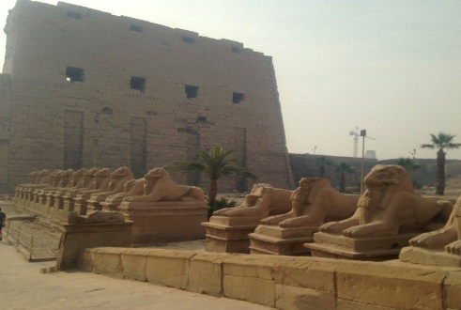
Birmingham Egyptology Forum
Forum Sessions Term One
About Us
Symposium
We meet fortnightly from 5-7pm in the CAHA Museum (Arts Building 305) for discussion and debate on topics concerning ancient Egypt and other related fields. Refreshments are provided, and all are welcome to join!
Friday 12th October: Myth Debunking (Come along with your favourite ‘myth’ about ancient Egypt for discussion!)
Friday 26th October: Decolonisation and early collectors: The Eton Myers Collection
Friday 9th November: The Value of Silence in ancient Egypt (Dr Ilaria Cariddi, Universita Ca’ Foscari Venezia) Friday 23rd November: TBC
Friday 7th December: Amelia Edwards and the EES (Dr Val Billingham) Followed by a Birmingham Egyptology Social!
Organised by postgraduate students, we run an annual symposium on a topic related to ancient Egypt – see our website for previous events.
Journal
Launched in 2013, we also run a peer-reviewed scholarly journal – available for free online!
www.birminghamegyptology.co.uk @UoBEgyptology
If you’re interested in leading a future Forum session, please contact the Forum Co-ordinator: jxt687@student.bham.ac.uk

